Slide 1


KEYBOARD JUMP GAME USING PYTHON
Guided by Prof. Shailendra Khumane
Team Members:
02 Jash Bhanushali
06 Shruti Dantala
15 Ritvik Kharbari

Slide 2
INTRODUCTION
Keyboard Jump Game is a speed typing game that helps in improving the typing speed of players.
The object of Keyboard Jump Game Python Project is to build a keyboard jump game that helps players to increase their typing speed. We use pygame, random, and time modules in this project.
In this project, the player has to press the same keys to the letters displayed on the game screen. If the player made an error while typing then the game gets over.

Slide 3
Usually, a typing game will require the player to quickly or precisely type in words - or individual letters, numbers, or other keys - that display on the screen to proceed in the game, functioning as both a challenge and a means to improve one's skill at touch typing.

Slide 4
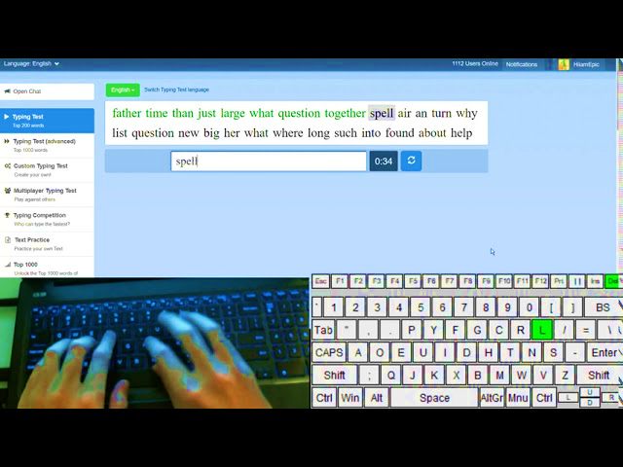
Expected Layout*

Slide 5


